Slide 1

Data Science Portfolio
Winston Vu

Slide 2
Introduction
The M.S in Applied Data Science provides students with mathematical knowledge and programming experience with the use of SQL, R, and Python.
The 7 core concepts of the program:
Developing an overview of major practices in data science
Collect and organize data
Identify patterns visually
Statistically, mining, and developing alternative strategies
Developing a plan of action
Demonstrating communication
Learn ethical decisions of data science practice

Slide 3

Classes
There are 4 classes involved that demonstrate the 7 core concepts:
IST 659 – Data Administration Concepts and Database Management
IST 652 – Scripting for Data Analysis
IST 736 - Text Mining
IST 718 – Big Data Analytics

Slide 4
IST 659 – Database Administration and Database Management
The class taught the basics of creating a database in SQL, performing an analysis in SQL, and managing a database in SQL.
A conceptual model and logical model was taught in order to learn how to organize the databases and link them together.
The project for the class revolved around the top 10 draft picks in the NFL from the years 2010 to 2020.

Slide 5
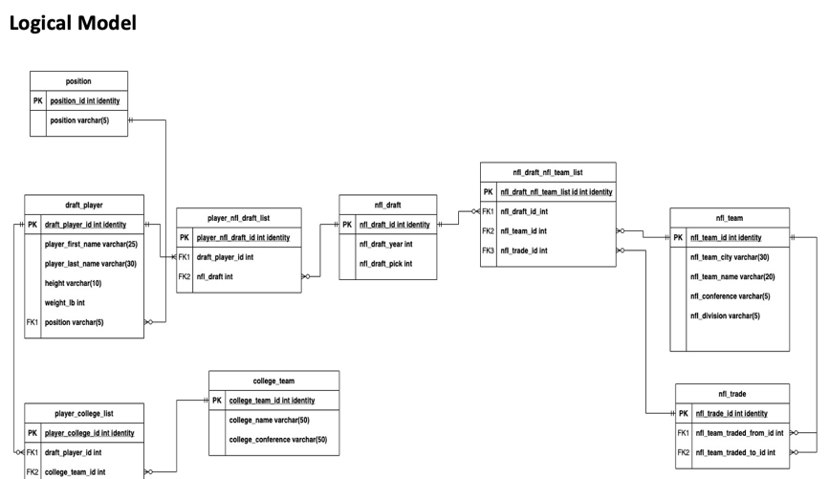
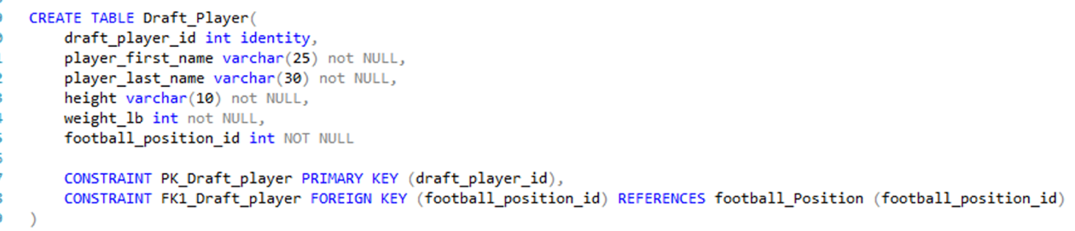
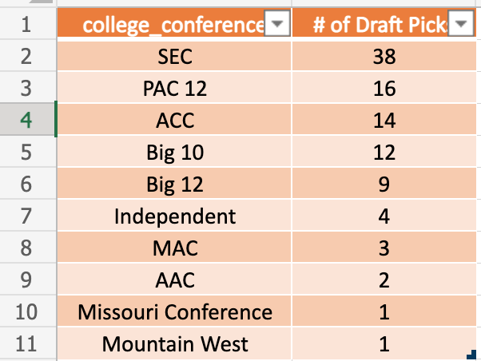
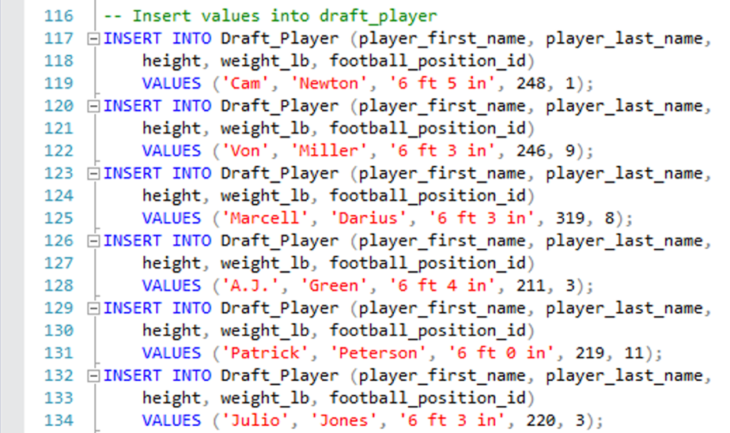
IST 659 – Project Details
The project involved creating a problem and relating it to business functions.
This project revolved around the top 10 picks in the NFL draft from 2010-2020.
A logical model was created to organize the database and find connections with the data.
Questions were created in order to find analytical insight on the data.

Slide 6
IST 659 - Reflection
Class taught about business and real-life scenarios in which data can be used by SQL.
There was organization to prepare how the data should be placed.
Data was manually collected, visualizations were used to organize the data, and patterns were found in data.

Slide 7
IST 652 - Scripting for Data Analysis
The class taught students about how to write scripts in Python
Scripts are important because it allows users to create a function, such as definitions and for loops, that could help for later use in analysis.
The project for this class involved a NCAA basketball dataset, which was used to project what factors led to wins.

Slide 8
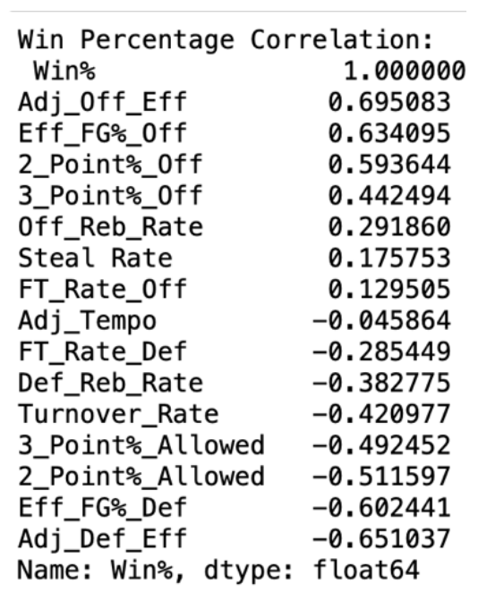
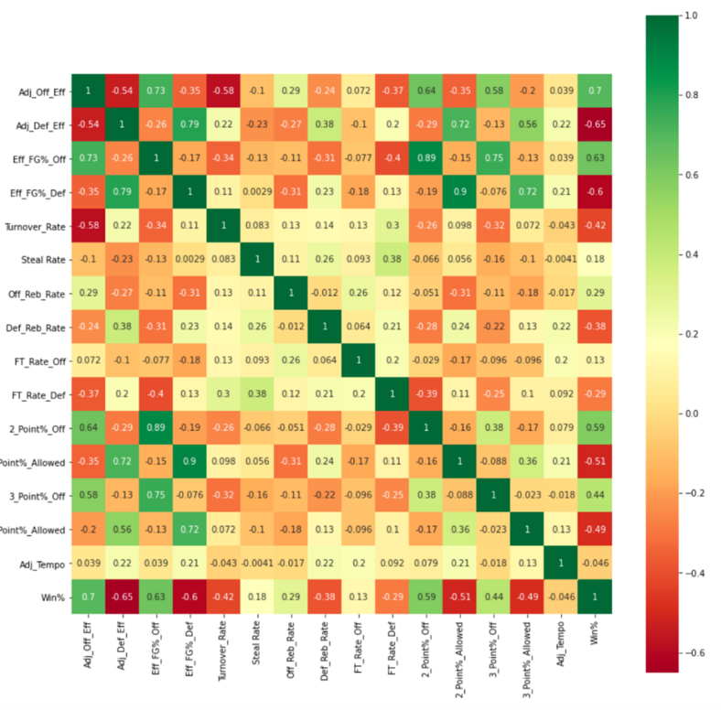
IST 652 – Project Details
The project involves using NCAA basketball data in order to make business related decisions while also accounting for the evolution of basketball.
Python functions used in the project are Variance Inflation Factor (VIF), linear regression, correlation, and other simple Python functions.
Visualizations were used to interpret data, such as correlation matrices or simple ordered correlation.

Slide 9
IST 652 - Reflection
The class was the first introduction into Python.
Class taught a lot about how to use the simple functions in Python, but also, it encouraged students to look further and use items that were not learned.
Though the class was a basic introduction, it provided the framework for future classes.

Slide 10
IST 736 – Text Mining
The class taught about using machine learning techniques to predict text analysis.
Text Mining is often used in voice recognition, chat bots, and classification.
The project consists of providing lyrics of different genres and predicting what genre the lyrics belonged to.

Slide 11
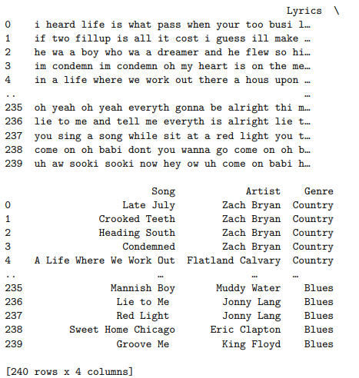
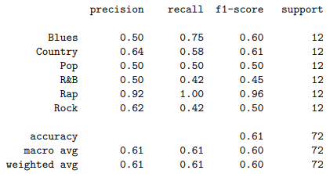
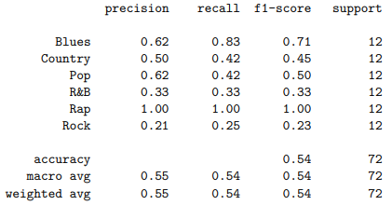
IST 736 – Project Details
Unigram Random Forest
Bigram Random Forest
Project was to create a classifier to match lyrics to its genre
Vectorization, tokenization, and train/test split were used to pre-process data.
Many classifiers were used, but the Random Forest provided the best metrics and the highest accuracy at 52.26%
Accuracies and metrics were not particularly high, but it is more realistic.

Slide 12
IST 736 - Reflection
Class taught about how process text data, use machine learning on text data, and apply it to real life business decisions.
Accuracies were not high, which means there could be much more to be done to improve the metrics.
Applied core concepts from the previous class, Natural Language Processing, in order to complete project.

Slide 13
IST 718 – Big Data Analytics
The class taught about many ways to approach data, such as approaching a time-series problem or a classification problem.
Different sets of code and machine learning tactics were learned to approach these types of problems.
The project was focused on climate change in Texas and how insurance premiums are impacted from climate change.

Slide 14
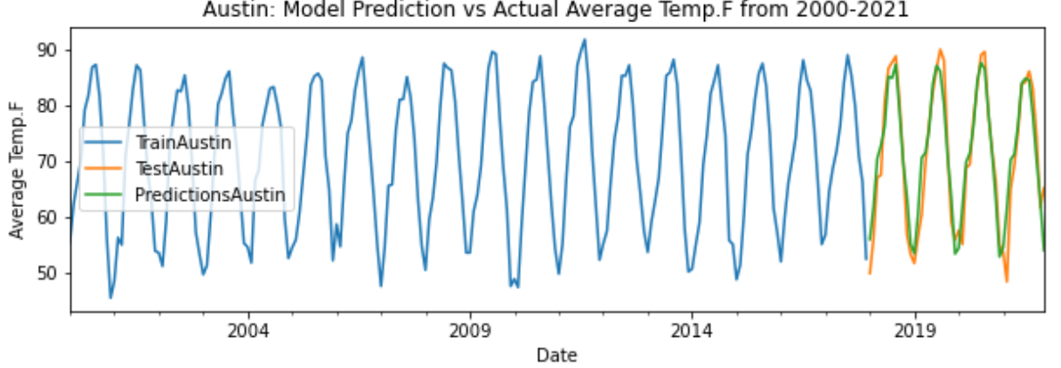
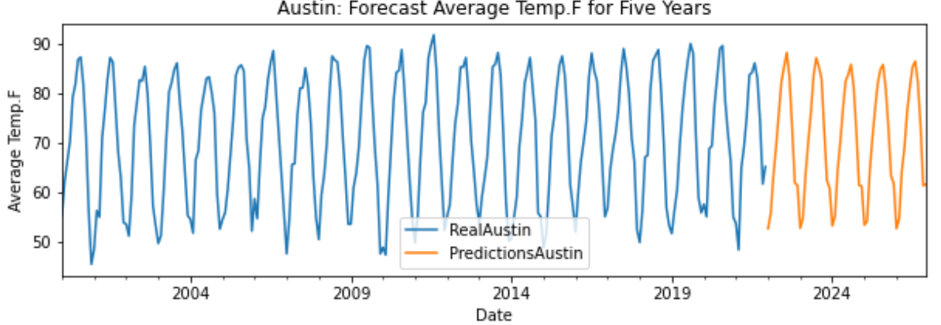
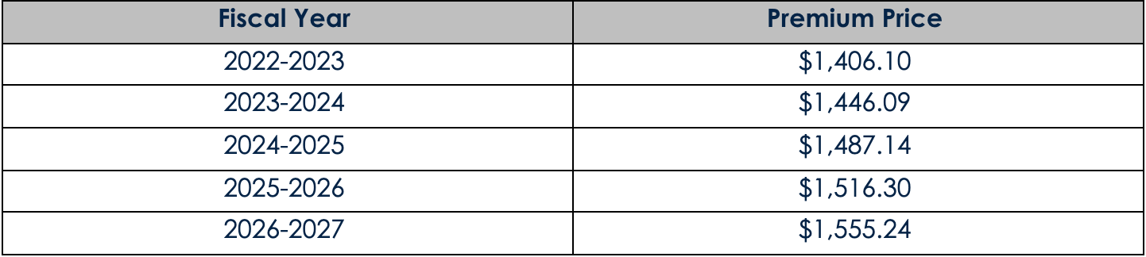
IST 718– Project Details
The project focused on a time-series based problem, focusing on predicting future temperatures, with the use of climate variables, as well as insurance premiums.
Results showed increases in premiums every year due to rising temperatures
The scikit-learn forecast package was used to train, test, and predict the future temperatures
Used because data was multivariate
The Prophet package was used to predict the insurance premiums price
Used because data was univariate

Slide 15
IST 718 - Reflection
There was many core concepts involved with the project, such as collection of data, communication, and alternative strategies
Scikit-learn forecast was a recently released package in 2022, and it was tested for this project.
Collaborated with other members to ensure timelines were met, and project was organized and completed.

Slide 16
Reflecting on Core Concepts
Developing an overview of major practices in data science
Each class provided details on the applications to data science and how to use techniques in SQL, Python, and R to accomplish tasks
Collect and organize data
The data could have been obtained through Kaggle, but most data was manually collected to reflect real life business scenarios
Pre-processing is an essential part due to its effect on the accuracies and metrics on a model or to let the model run.
Identify patterns visually, statistically, and data mining
Graphs and visuals were used to understand the data and communicate the data to an audience
Basic graphs, heatmaps, basic statistics, or simple tables were used to see if there are any patterns or insights within the data
Developing alternative strategies
Learning new functions and algorithms not presented during the class helped grow the knowledge for the data science world.
Developing a plan of action
A plan of action was created in order to prepare for a project and how to approach certain scenarios
It is essential to plan ahead before running wild with the problem a person is trying to solve
Demonstrating communication
Communication can involve with people or results
Communication could involve working with a team to complete tasks for a project or communicating results within a paper or a presentation
Learn ethical decisions of data science practice
Classes taught about how to be ethical with data by not being bias towards certain results and implementing data integrity and data security to protect the data from outside invaders.

Slide 17
Final Thoughts
The program has taught a lot about not only the coding aspect of data, but also the ethical concerns and business implications as well
Each project allowed for a team to work together to solve the problem or work solo in order to prepare for the real world
Enjoyed learning all aspects of data, the approaches, and will apply all my learnings in my job as a Jr. Data Scientist.

